Slide 1

Student Registration System
Developed By: Juan Alcala

Slide 2
Software Requirements Specification
Registration System for Students
Key features Include the following:
Student Account Registration
Student Login System
Student Registration: Add/Remove
Registered Course Waitlist
Course Capacity/Waitlist Capacity
Student Logout

Slide 3
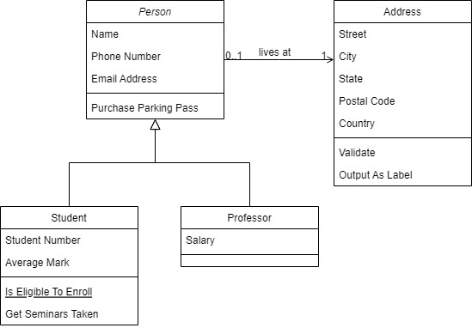
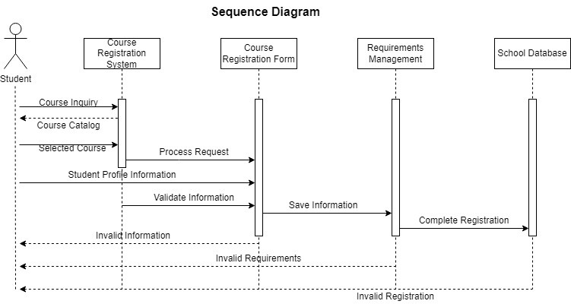
UML Design Models
Class Diagram

Slide 4
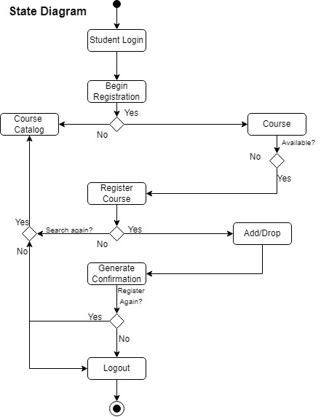
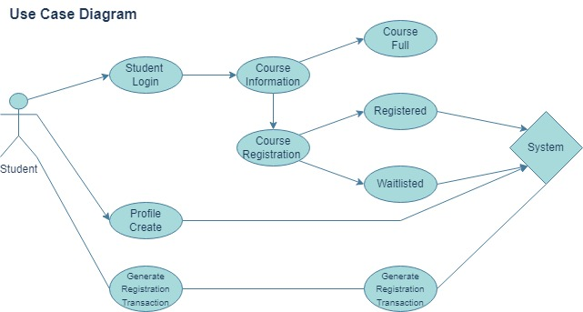
UML Design Models Continued

Slide 5
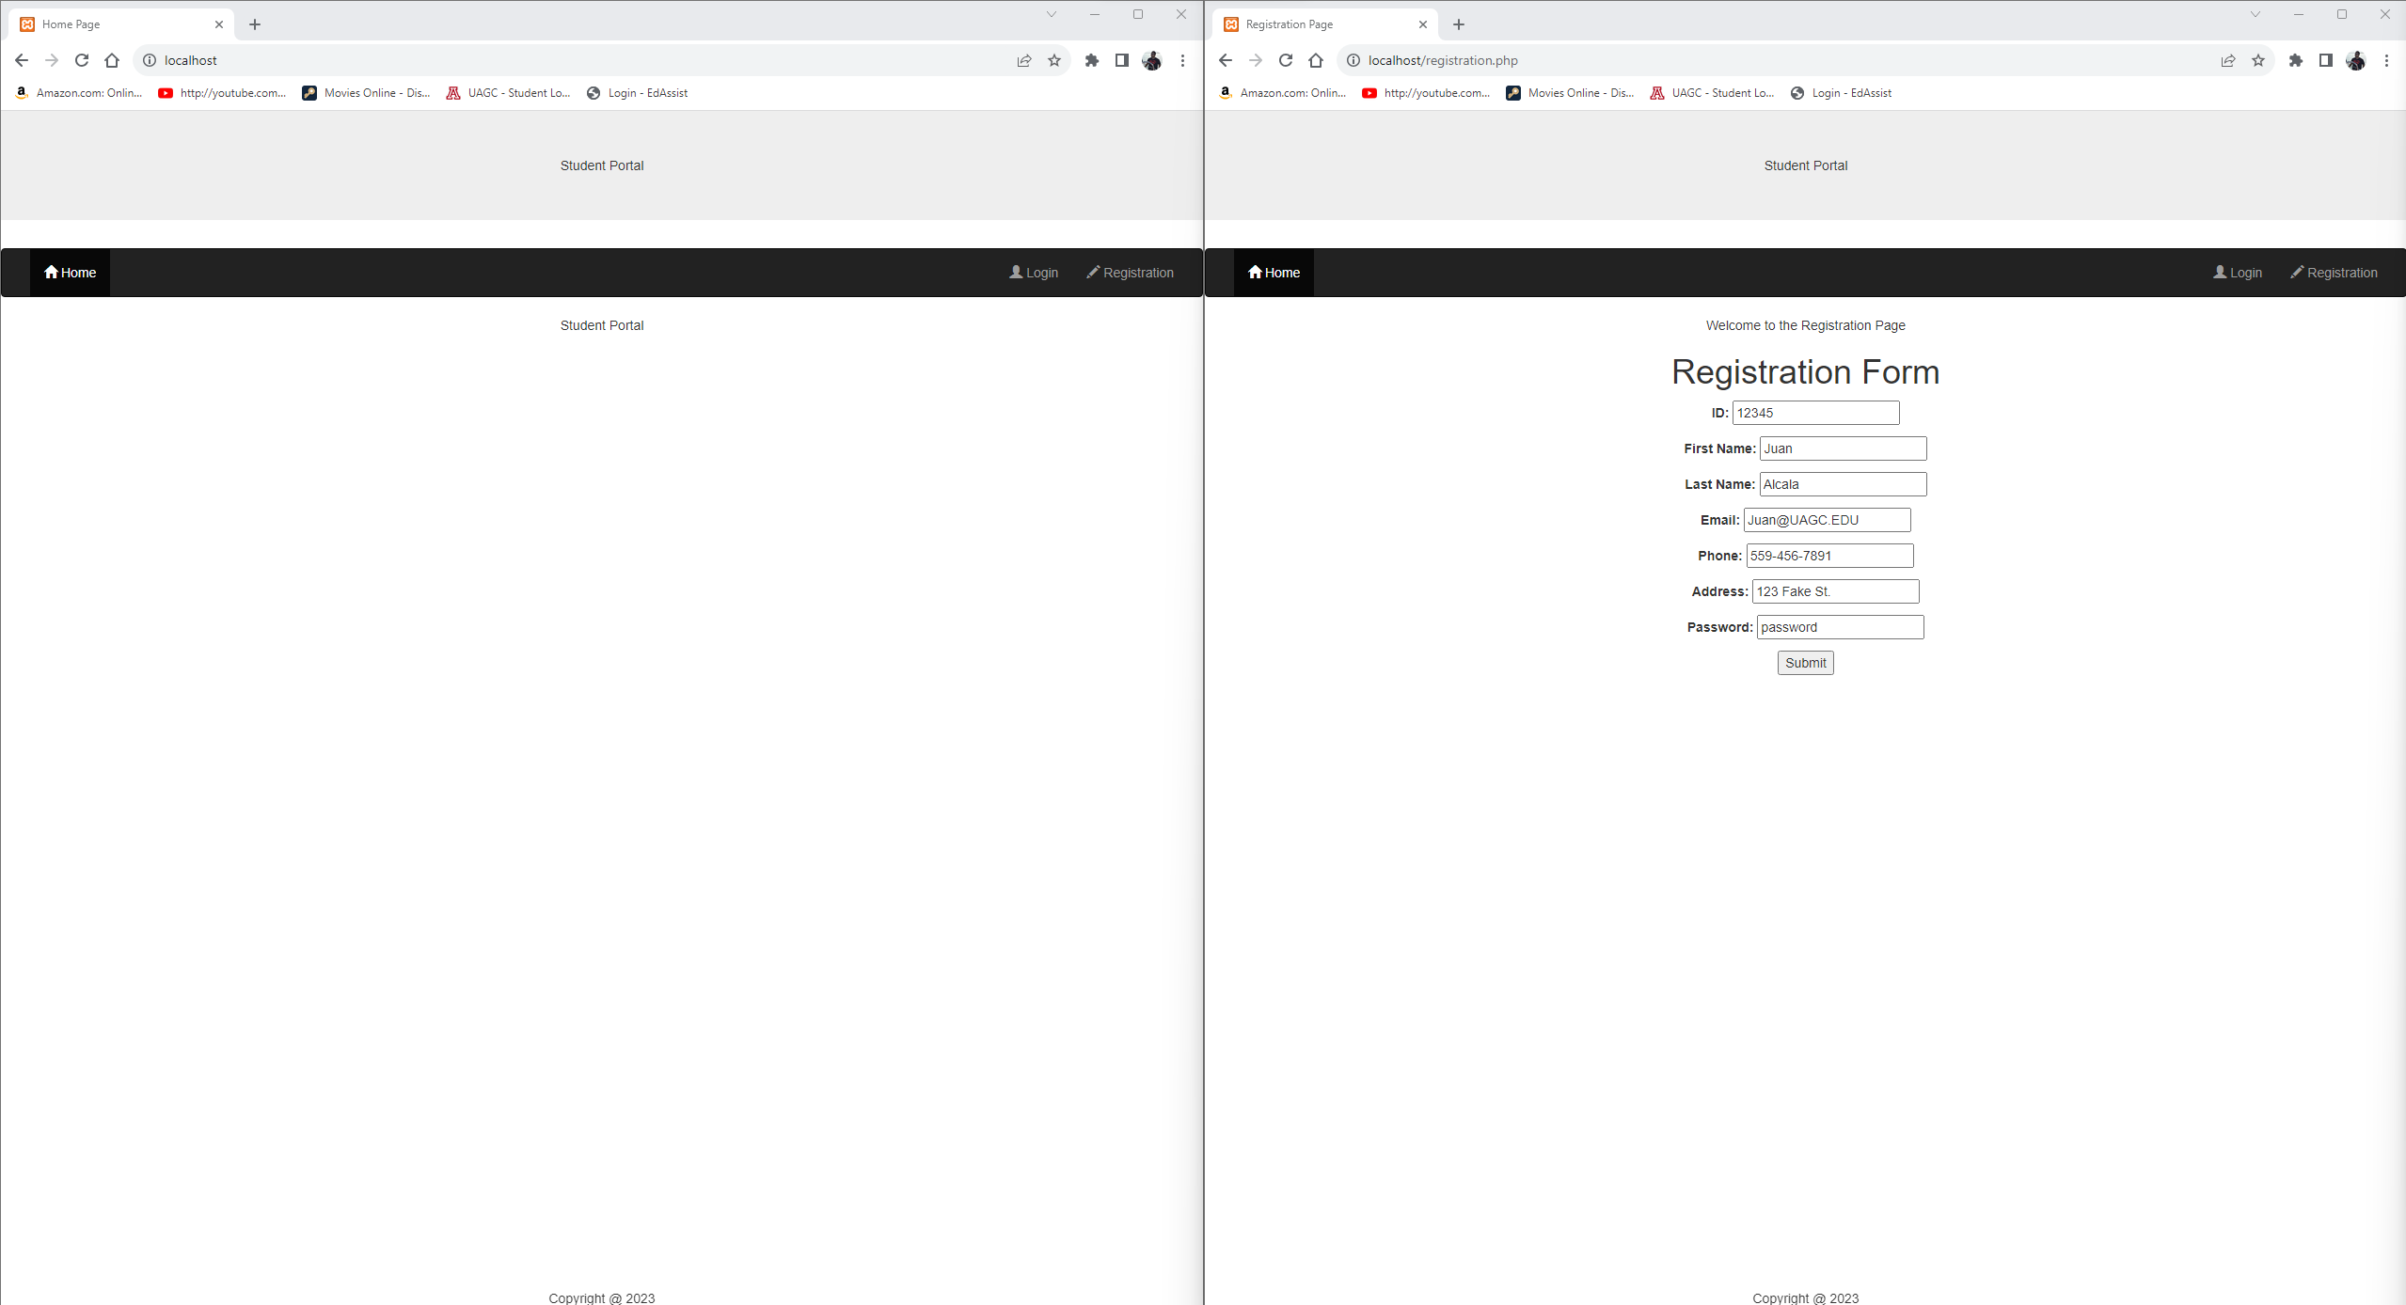
Registration System
Landing
Registration

Slide 6
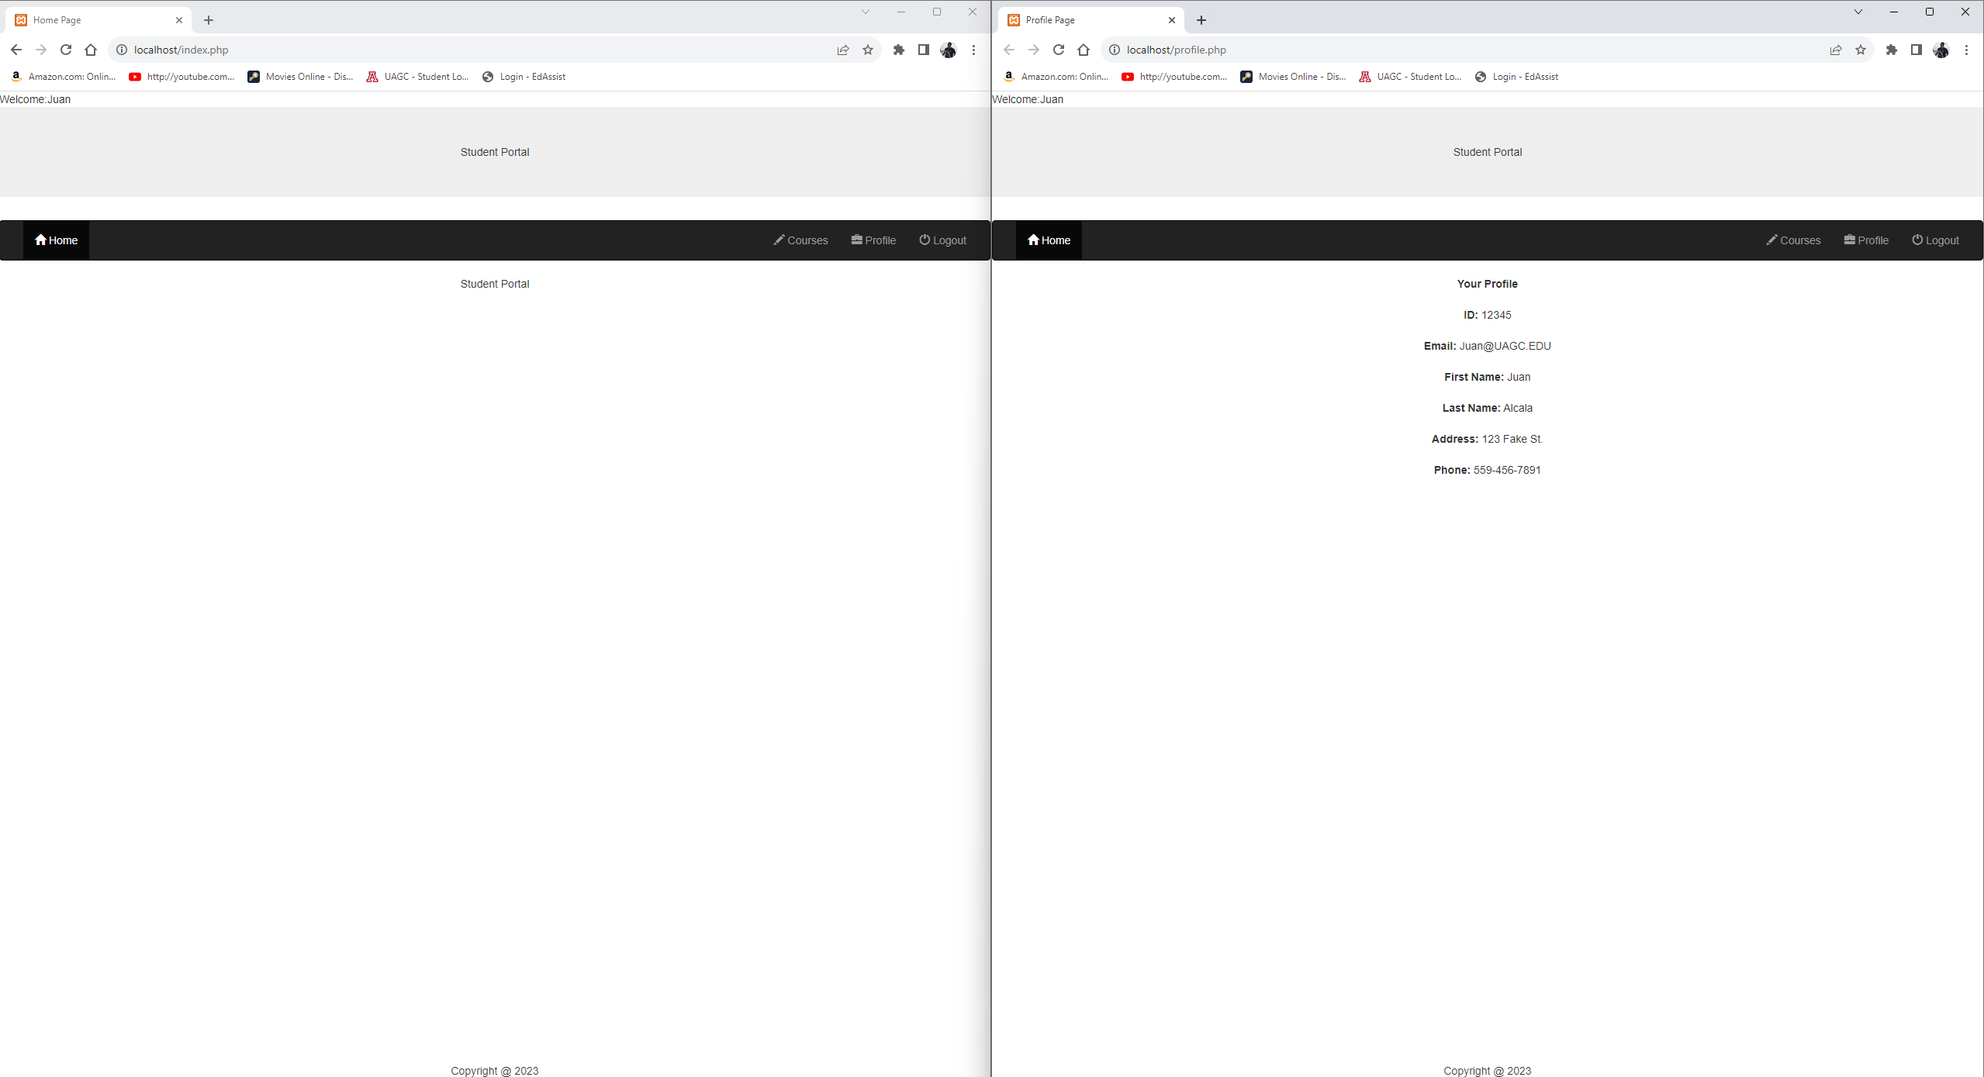
Registration System
Logged In
Profile

Slide 7
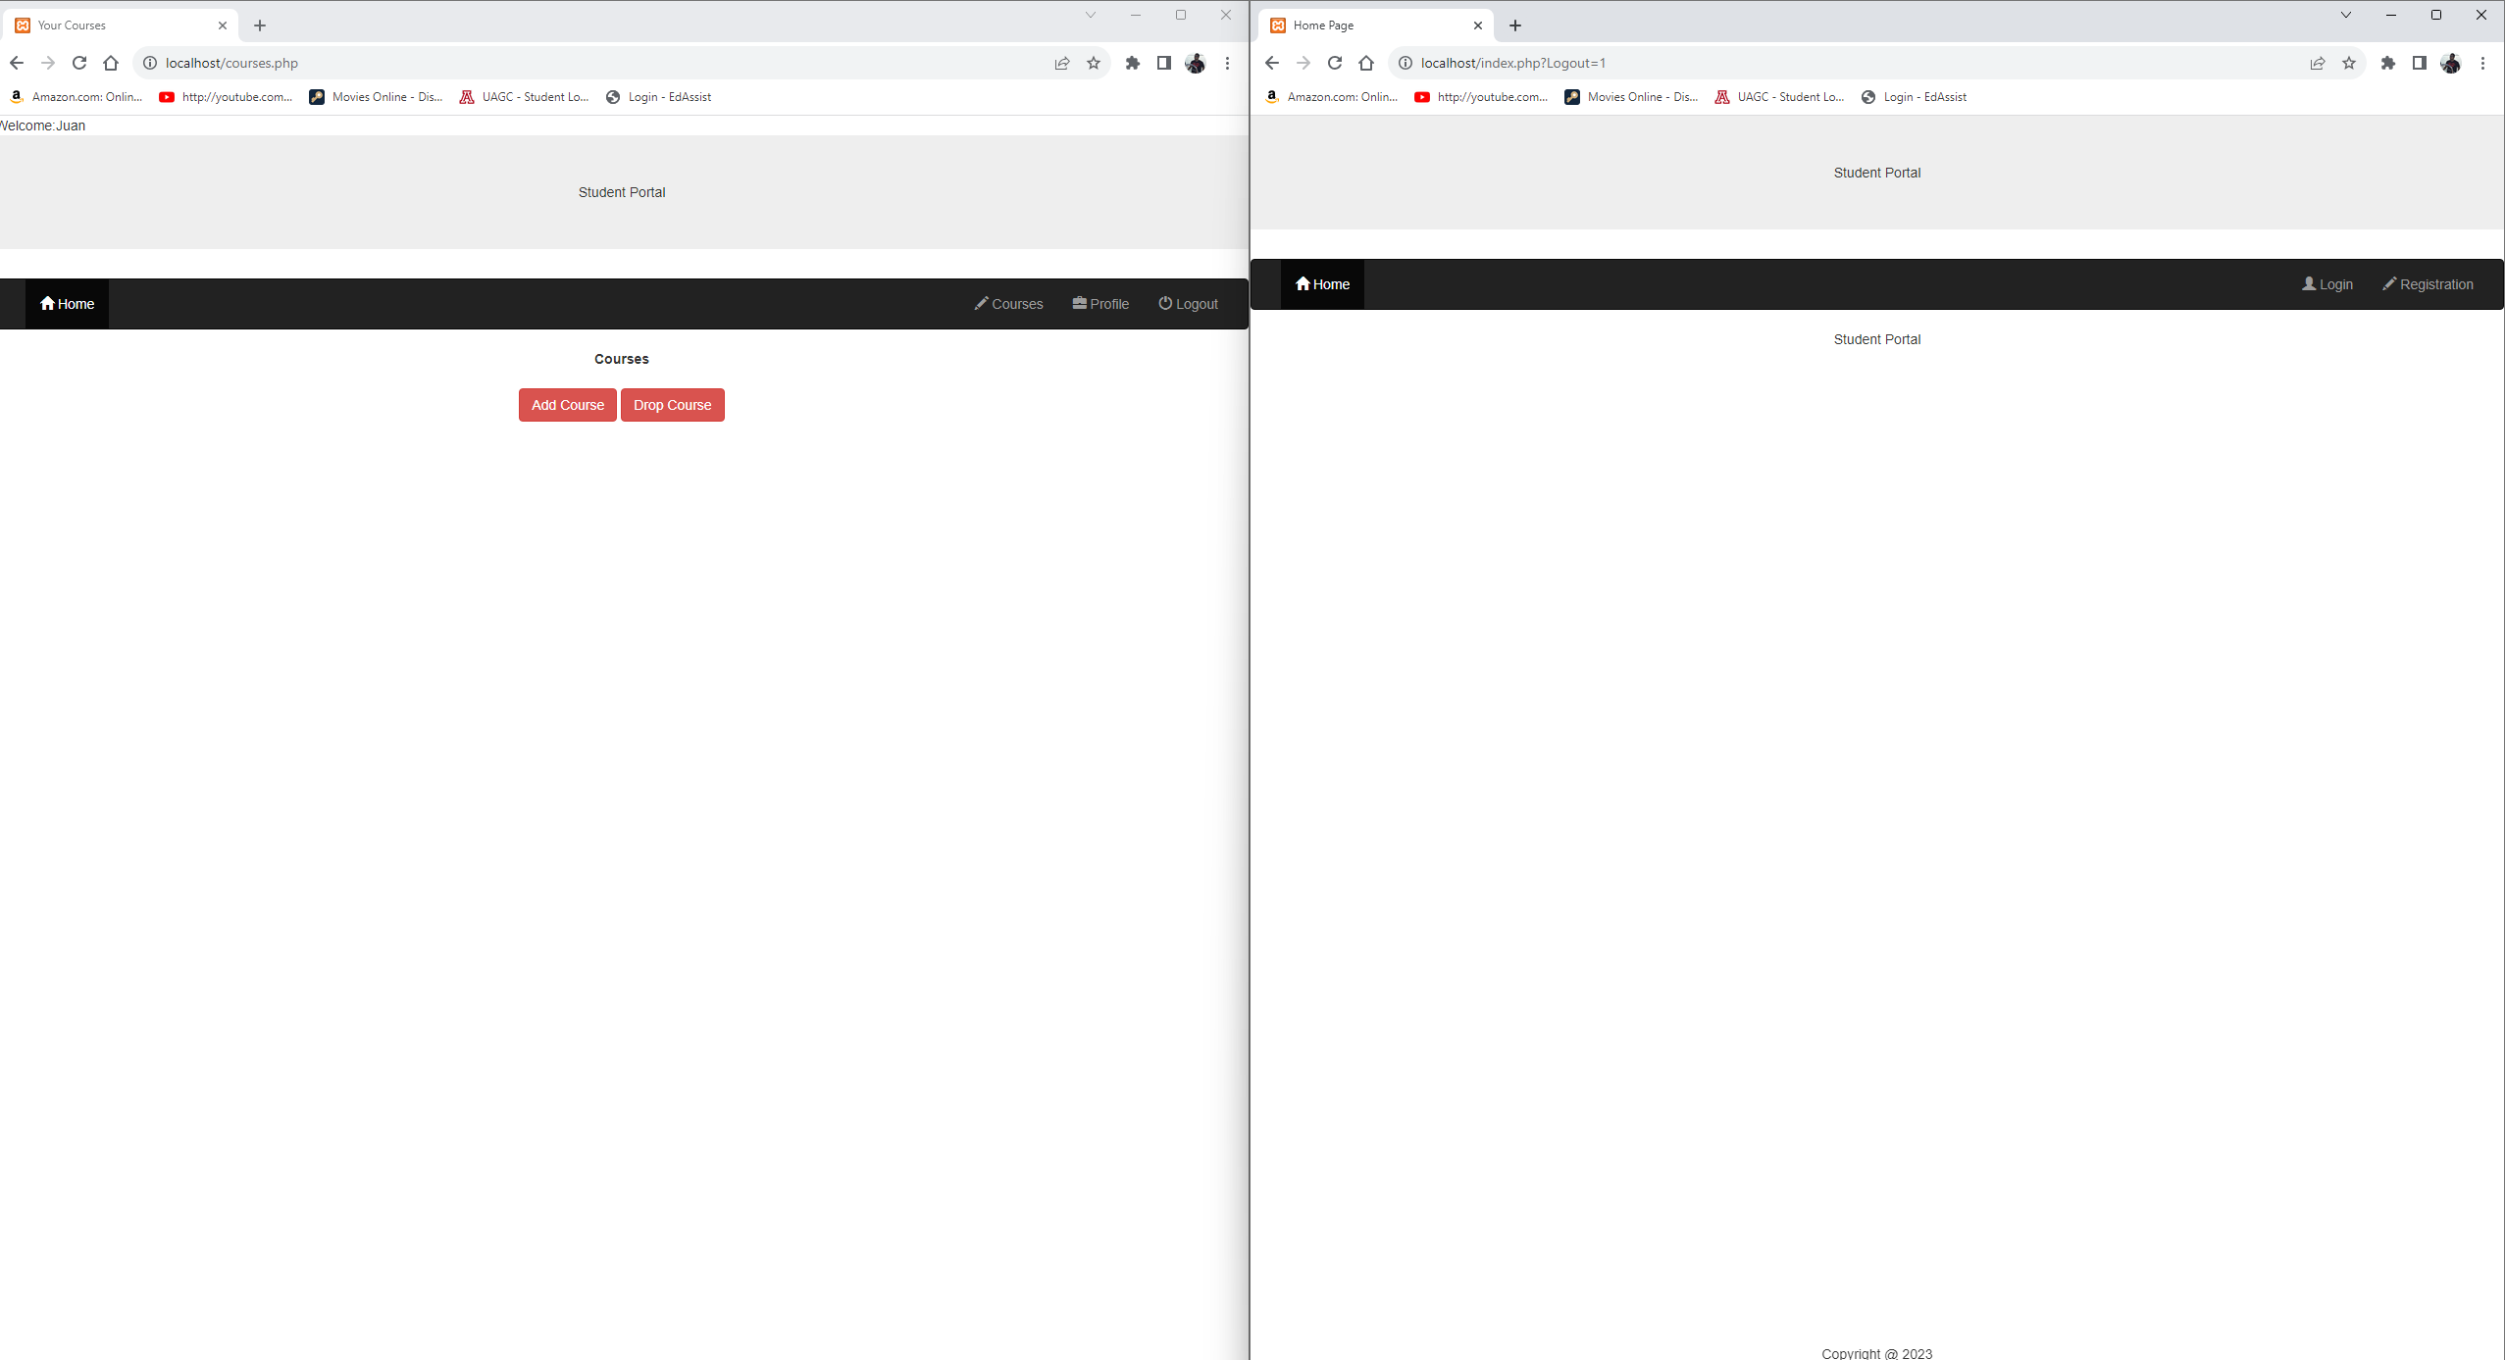
Registration System
Add/Remove Courses
Logged Out

Slide 8

Thank You

